Slide 1

Multi‑Objective Sizing for Hybrid Solar Systems Using Synthetic Residential Loads and Machine‑Learning‑Based Long‑Term Solar Irradiance Forecasts.
MSc. Mechatronic Engineering
Proposal presentation
Dan Munene Muchiri
ENM321- 2049/2024
Supervisors:
Dr. James Wamai Mwangi
Dr. Jackson G. Njiri

Slide 2
Presentation Outline
Introduction
Problem statement
Objectives
Literature Review
Summary of Gaps
Methodology
Expected Outcomes
Budget and time plan

Slide 3
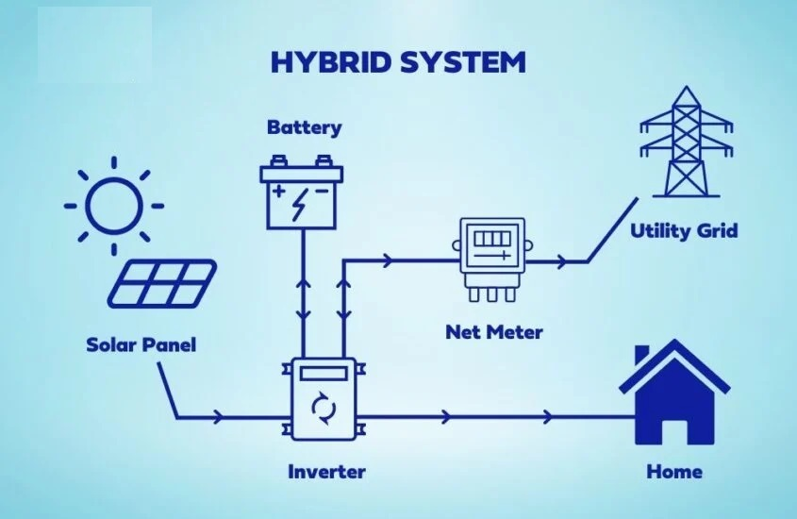
Introduction
Hybrid PV–battery–grid systems:
A hybrid system couples rooftop PV, a battery, and the utility grid through a smart inverter, enabling PV power to:
supply household loads directly,
charge the battery for later use, or
export or bypass to the grid when needed.​
[https://www.jesaton.co.ke/]

Slide 4
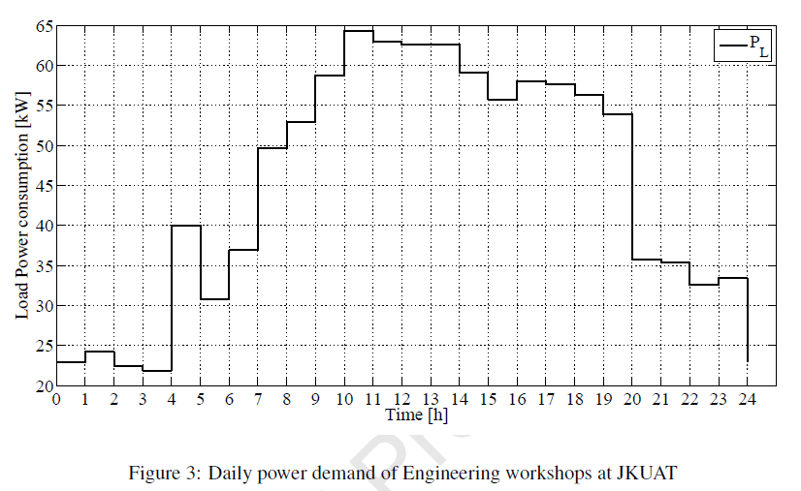
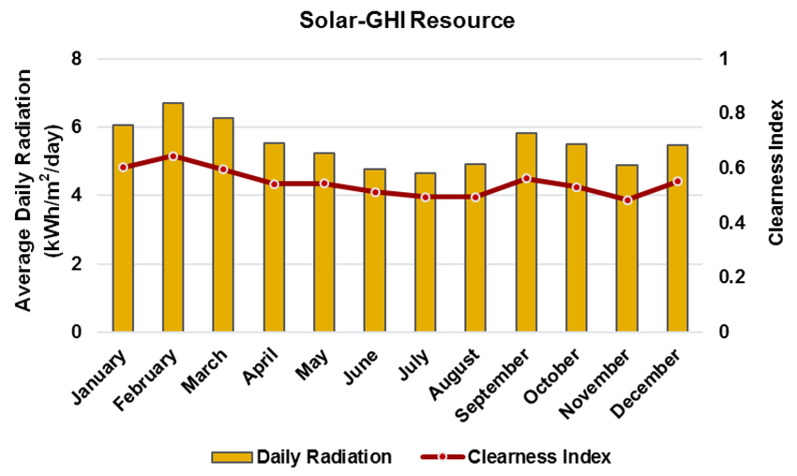
Problem statement
[Ndwali et al., 2019]
1. Lack of Electrical Load Profile
Installers currently use appliance lists instead of time‑resolved load profiles.
Most sites lack power meters, so demand is unmeasured.
Load monitoring takes longer than clients are willing to wait.
2. Solar irradiance Variability
Installers rely on a single average sun‑hours value, masking real variability in solar irradiance.
Designers need a better estimate of future PV production to size systems
3. Installation cost and Grid dependence
Installers need trade off upfront cost, autonomy, and bill savings to persuade customers.
[Anastasopoulou et al., 2016]

Slide 5
Objectives
Appliance list & wattages
Time‑of‑use probabilities
Site location
Main objective
To develop an integrated framework that combines residential load modelling, long‑term solar irradiance forecasting, and multi‑objective optimization for sizing hybrid solar systems.
Specific objectives
To develop a robust model for generating realistic synthetic residential electricity load profiles.
To develop and validate a machine‑learning model for long‑term solar irradiance forecasting.
To formulate and apply a multi‑objective optimization method for sizing hybrid solar systems.
Input
Synthetic load profiling
ML long‑term solar forecasting
Multi‑objective sizing optimization
Process
PV, battery, inverter sizes
Cheapest option
Balanced option
High‑autonomy option
Output

Slide 6
Literature Review
Authors | Method | Key Findings | Identified Gap
Pirouz et al., 2025 | Multi-objective optimization for sizing AI models for PV/load forecasting BESS Scheduling algorithm | AI-enhanced multi-objective models yield Pareto-optimal BESS sizes and schedules that trade off cost, self-sufficiency, reliability, and battery aging. | AI used for short term prediction for BESS control not long term for sizing. Assumes access to load data. Objective models aren’t tailored to installer needs.
Azizi et al., 2023 | Compared MLP, LSTM, GRU, CNN, and CNN‑LSTM for long‑term (10‑year) monthly forecasting of GHI and temperature using NASA data (1984–2021) for Zahedan | CNN with four inputs gave the best GHI performance (test RMSE ≈12.87 W/m², R² ≈95.77%) and good temperature accuracy (RMSE ≈1.75 °C, R² ≈95%).​ | Need for alternate location climate justification. Lack of benchmark against baselines like Random Forest or SVM regression Does not include prediction intervals and uncertainty analysis.
Leach et al., 2020 | Adapted the CREST probabilistic demand model to build a minute‑resolution household load model. | The model generates realistic 1‑minute load profiles for cooking and non‑cooking uses at single‑household and multi‑household levels. | Limited time‑use/occupancy data beyond cooking. Lack of weekday/weekend variance No quantitative validation

Slide 7
Summary of Gaps
Lack of an integrated framework combining synthetic loads, long-term solar forecasting, and multi-objective sizing.​
Limited methods that work under real installer data constraints (no meters, no detailed irradiance records).​
Few tools translate technical sizing into simple options that show cost–autonomy–grid trade-offs.​
Limited use of uncertainty in forecasts to inform risk-aware sizing decisions.

Slide 8
Methodology
Residential load modelling
Select a representative case-study household.
Collect appliance list, wattages, usage patterns, occupancy, and dwelling characteristics.
Install a power meter and record the household load profile.
Clean and pre-process the measured load data.
Implement a CREST-type probabilistic demand model using the collected data.
Generate synthetic high-resolution load profiles.
Validate synthetic profiles against the measured load profile using basic error metrics and visual checks.

Slide 9
Methodology
Solar irradiance forecasting
Acquire long-term historical GHI and temperature data for these locations from NASA Power Dataset.
Clean and pre-process the data (gap filling, outlier handling, feature construction, train/validation/test splits).
Train several machine learning models (e.g., CNN, LSTM, Random Forest, SVR) for long-term, monthly or yearly solar irradiance forecasting.
Evaluate models using error metrics such as RMSE and correlation coefficient and select the best-performing model.
Generate long-term irradiance forecasts for the study horizon and derive PV energy yield time series.
Quantify forecast uncertainty (e.g., ensembles or prediction intervals) for use in system sizing.

Slide 10
Methodology
Multi-objective sizing optimization
Formulate a hybrid PV–battery–grid model using the synthetic load profiles and solar forecasts as inputs.
Define decision variables for PV array size, battery capacity, and inverter rating.
Specify objective functions (e.g., minimize lifecycle cost, minimize grid energy use, maximize reliability/autonomy) and technical constraints.
Apply a suitable multi-objective optimization algorithm (e.g., NSGA-II–type) to obtain a Pareto front of feasible system sizes.
From the Pareto front, select three representative designs: cheapest, balanced, and high-autonomy options, and compute key performance indicators for each.

Slide 11
Expected Outcomes
A validated probabilistic load model capable of generating realistic high‑resolution synthetic demand profiles for the case-study household.​
A tested machine-learning model that provides accurate long-term GHI forecasts and corresponding PV energy yield time series, including basic uncertainty estimates for the study location.
A set of Pareto-optimal PV–battery–grid system sizes summarized into three practical design options (cheapest, balanced, high-autonomy) with quantified objective indicators.

Slide 12
Budget
Item | Description | Estimated cost (KES)
Laptop | Mid‑range laptop for simulations and ML models | 70,000
Power meter | Single‑phase DIN‑rail meter with for household load monitoring. | 30,000
Transport | Matatu/taxi fares | 3,000
Miscellaneous expenses | Printing, data bundles, etc. | 7,000
Total |  | 110,000

Slide 13
Work Plan
Activity | Mar | Apr | May | Jun | Jul | Aug | Sep | Oct | Nov | Dec | Jan | Feb
Literature review | ● | ● | ● | ● | ● | ● | ● | ● | ● | ● | ● | ●
Proposal & defense | ● | ● | ●
Online survey & data processing |  | ● | ●
Load model development |  |  | ●
Model validation & Case study evaluation |  |  | ● | ● | ●
DL irradiance model training |  |  |  | ● | ● | ● | ●
PV sizing optimisation |  |  |  |  | ● | ● | ● | ●
Framework validation & metrics |  |  |  |  |  |  | ● | ●
Results analysis |  |  |  |  |  |  | ● | ● | ●
Thesis writing |  |  |  |  |  |  | ● | ● | ● | ● | ●
Journal paper drafting & submission |  |  |  |  |  |  |  |  | ● | ● | ●
Thesis revision & defense |  |  |  |  |  |  |  |  |  | ● | ● | ●

Slide 14
References
B. Pirouz, “Optimal sizing and operation of battery energy storage systems using multi‑objective optimization and AI‑based forecasting,” Applied Energy, vol. 347, 125138, 2025 G. Leach, T. Oreszczyn, and R. Lowe, “A probabilistic demand model for low‑carbon residential energy system design,” Energy and Buildings, vol. 206, pp. 109–121, 2020.​​ N. Azizi, M. Yaghoubirad, M. Farajollahi, and A. Ahmadi, “Deep learning‑based long‑term global solar irradiance and temperature forecasting using time series with exogenous variables,” Renewable Energy, vol. 204, pp. 1301–1317, 2023.​

Slide 15


